Slide 1
Computer & Information Security
Shell/PowerShell/Terminal Environment

Slide 2
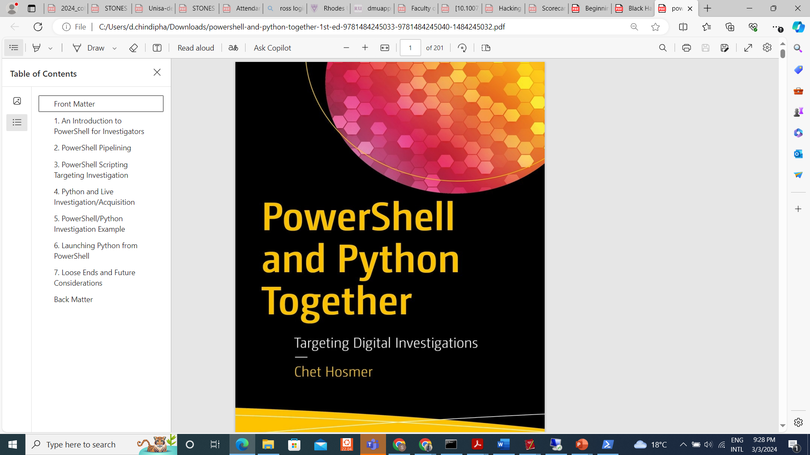
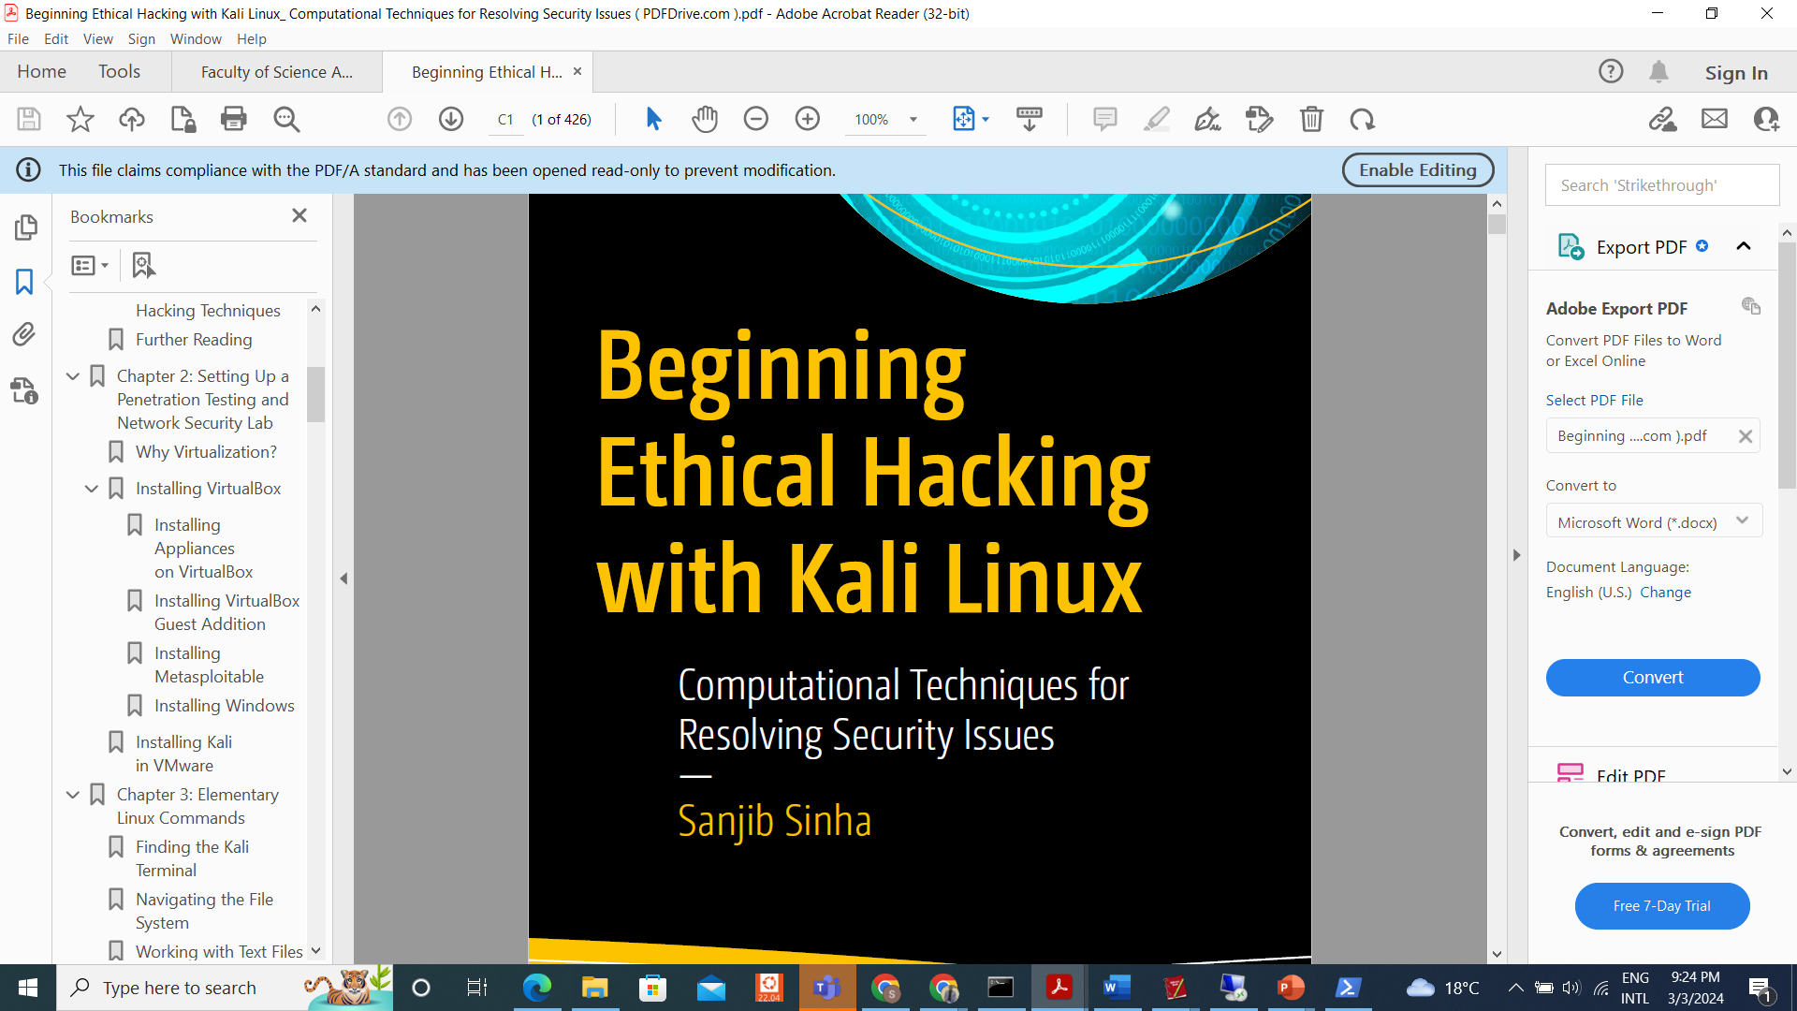

Slide 3
Core Reading
PowerShell and Python together: Chapters 1& 2
Begin Ethical Hacking with Kali Linux: Chapter 3
Linux Basics for Hackers Chapters 5, 8 & 17
Bash guide for beginners: Chapter

Slide 4
Shell
A shell is a special user program that provides an interface for users to use operating system services.
Shell accepts human-readable commands from users and converts them into something which the kernel can understand.
The shell has many other names:
the terminal, the command prompt, bash…​
PowerShell, if you’re looking at Windows and feeling blue
picoCTF account gets access to a web-based Linux shell.
Learning Shell for someone who has only "spoken" GUI is like learning a second language.
This is good news and bad news.
The good news is that Shell and GUI are languages for something you’ve been using for probably years,
but the bad news is there is a whole new vocabulary with only a handful of cognates (words that sound and mean the same in both languages) here and there.

Slide 5
PowerShell
PowerShell is a powerful command-line shell and scripting language developed by Microsoft for system administration, task automation, and configuration management.
It is designed to provide a more efficient and intuitive way to manage Windows environments, allowing administrators and developers to perform a wide range of tasks through command-line interface (CLI) commands and scripts
Cmdlets (Command-let) are at the core of PowerShell's flexibility and power, enabling users to perform a wide range of tasks, from system administration to automation and scripting, in a consistent and efficient manner.

Slide 6
Basic Cmdlets
Get-Command: Lists all available cmdlets in PowerShell.
Get-Help: Displays help information about PowerShell cmdlets and concepts.
Get-Process: Retrieves information about running processes on the system.
Stop-Process: Stops one or more running processes.
Get-Service: Retrieves information about installed services on the system.
Start-Service: Starts one or more stopped services.
Stop-Service: Stops one or more running services.
Restart-Service: Stops and then starts one or more services.

Slide 7
…
Get-EventLog: Retrieves events from event logs on the local or remote computer.
Clear-EventLog: Clears one or more event logs.
wget is a versatile tool for downloading files from the web, and its command-line interface makes it suitable for use in scripts and automation tasks. It is widely used by system administrators, developers, and power users for various downloading needs.

Slide 8
PowerShell commands commonly used for security-related tasks
Get-ExecutionPolicy: Retrieves the current execution policy settings, determining the PowerShell script restrictions.
Set-ExecutionPolicy: Sets the execution policy for PowerShell scripts to control the level of security for script execution.
Get-Acl: Retrieves the access control list (ACL) for a file or directory, showing the permissions granted to users and groups.
Set-Acl: Sets a file or directory's access control list (ACL), allowing users to modify permissions and security settings.
Get-AuthenticodeSignature: Retrieves the digital signature information for a file, helping to verify its authenticity and integrity.
Get-ChildItem -Recurse | Where-Object {$.Attributes -match "Hidden" -or $.Attributes -match "System"}: Retrieves hidden or system files and directories recursively, allowing users to identify potentially hidden threats or malicious files.

Slide 9
…
Get-Command -Module Defender: Lists all cmdlets available in the Windows Defender module, providing access to security-related commands for managing Windows Defender antivirus settings and scans.
Get-EventLog -LogName Security: Retrieves security-related events from the Windows security event log, allowing users to monitor security events and detect suspicious activities.
Get-WinEvent -LogName Security -MaxEvents 1000: Retrieves a specified number of security-related events from the Windows event log, allowing users to analyze recent security events.

Slide 10
Get-Process | Where-Object {$_.MainWindowTitle -ne ""}: Retrieves running processes with visible windows, helping users identify potentially malicious processes running on the system.
Get-NetFirewallRule: Retrieves the configured Windows Firewall rules, allowing users to view and manage firewall settings.
Get-NetTCPConnection: Retrieves active TCP connections on the system, helping users monitor network activity and detect suspicious connections.
Get-NetIPAddress: Retrieves configured IP addresses on the system, allowing users to monitor network interfaces and configurations.
Test-NetConnection: Performs network connectivity tests, including ping tests and port scans, helping users diagnose network connectivity issues and identify potential security vulnerabilities.
Get-EventLog -LogName Application, System -After (Get-Date).AddDays(-1): Retrieves application and system events from the Windows event logs for the past day, helping users monitor system health and detect anomalies.

Slide 11
Get-WindowsUpdateLog: Retrieves Windows Update logs, providing information about installed updates, failed updates, and update status.
Get-ScheduledTask: Retrieves configured scheduled tasks on the system, allowing users to monitor and manage scheduled tasks that may affect security.
Get-Certificate: Retrieves information about installed certificates on the system, helping users manage digital certificates and verify trust.
Get-BitLockerVolume: Retrieves information about BitLocker-encrypted volumes on the system, allowing users to manage disk encryption settings and keys.
Get-SmbShare: Retrieves information about shared folders on the system, helping users monitor file sharing settings and permissions

Slide 12
Take Home Messege
These PowerShell commands cover a range of security-related tasks, including monitoring system events, managing permissions, analyzing network activity, and verifying system integrity. They are valuable tools for security professionals and system administrators responsible for maintaining the security of Windows environments.

Slide 13
Why should I take the trouble to learn Linux commands?
You will have to master Linux programming because without mastering Linux programming, you cannot master ethical hacking or penetration testing as a whole
when you need to update and upgrade your Kali distribution, you have to open the sources.list file and uncomment a few lines
When you want to change the permission of a file system, copy a file, or permanently remove a file
When you want to add a new user to your system and get a list of files that are currently in the directory where you are, including the hidden files.
when you work with some hacking tools and frameworks, you have to use the terminal
E.g Nmap or Metasploit,

Slide 14
Elementary Linux Commands
Is: Displays information about files in the current directory.
Pwd (print working directory): Displays the current working directory.
Mkdir: Creates a directory
cd: To navigate between different folders.
rmdir: Removes empty directories from the directory lists.
Cp: Moves files from one directory to another
Mv: Rename and Replace the files
Rm: Delete files
Touch: Create empty files
Nano: Display file contents on terminal
built-in Leafpad text editor

Slide 15
Clear: Clear terminal
Man: Access manual for all Linux commands
Grep: Search for a specific string in an output
Wget: download files from the internet.

Slide 16
Let’s Test our new knowledge in CTF
Log in PicoCTF
Fix_me.py
Fix_me_2.py
Scavenger_hunt
insp3ct0r

